Slide 1

Altitude control of Cessna Citation 500 aircraft
Crippa Davide 509769
Moroni Gianluca 503424
Mongini Paolo 507997
Bordonali Mattia 496468
Notes:
NOTA:
per cambiare l'immagine in questa diapositiva, selezionarla ed eliminarla. Quindi fare clic sull'icona Immagini nel segnaposto per inserire l'immagine desiderata.

Slide 2
Introduction
Variables
States:
$x_{1}$: Angle of attack [rad]
𝑥_1: Angle of attack [rad]
$x_{2}$: Pitch angle [rad]
𝑥_2: Pitch angle [rad]
$x_{3}$: Pitch rate [rad/s]
𝑥_3: Pitch rate [rad/s]
$x_{4}$: Altitude [m]
𝑥_4: Altitude [m]
Inputs:
$u$: Elevator angle [rad]
𝑢: Elevator angle [rad]

Slide 3
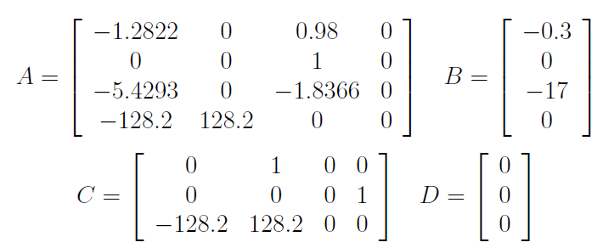
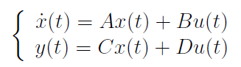
Introduction
Model
The model is linearized at an altitude of 5000 m and a speed of 128.2 m/sec

Slide 4
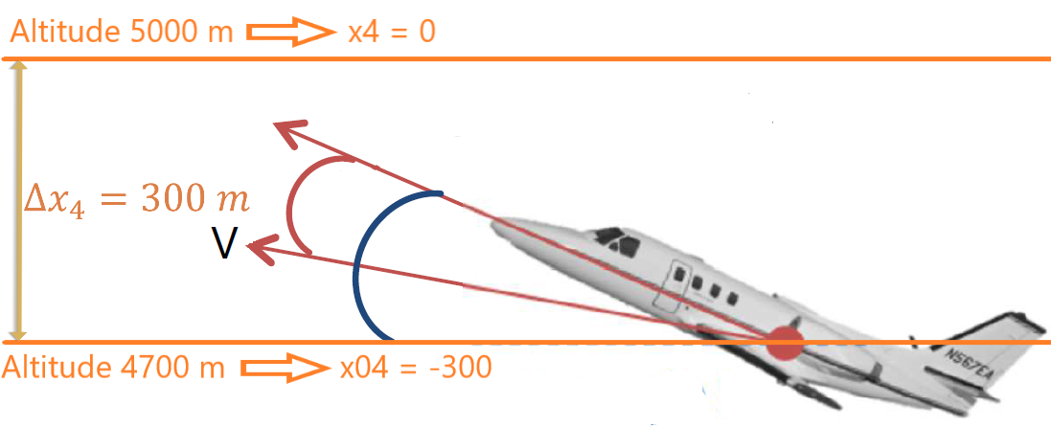
Introduction
Constraints
Elevator angle ($u$): $±15° (±0,262$rad)
Elevator angle (𝑢): ±15° (±0,262 rad)
Pitch angle ($x_{2}$): $±20°$ ($±0,349$ rad)
Pitch angle (𝑥_2): ±20° (±0,349 rad)
Elevator slew rate: $±30°/sec$ ($±0,524$ rad/s)
Elevator slew rate: ±30°/𝑠𝑒𝑐 (±0,524 rad/s)
Initial States
$x_{01}$: Angle of attack = 0°
𝑥_01: Angle of attack = 0°
$x_{02}$: Pitch angle = 15° = 0.2618 rad
𝑥_02: Pitch angle = 15° = 0.2618 rad
$x_{03}$: Pitch rate = 0 rad/s
𝑥_03: Pitch rate = 0 rad/s
$x_{04}$: Altitude = -300 m
𝑥_04: Altitude = -300 m

Slide 5
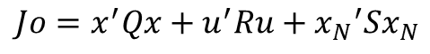
LQ Controller
General rules for computing LQ controller
Q
R
Q
R
$${Jo=x}^{′}Qx+u^{′}Ru+{x_{N}}^{′}Sx_{N}$$
$$Q≥0, R>0, S≥0$$
Aggressive action on the states
Soft action on the control
Soft action on the states
Aggressive action on the control
Notes:
PUNTO 1

Slide 6
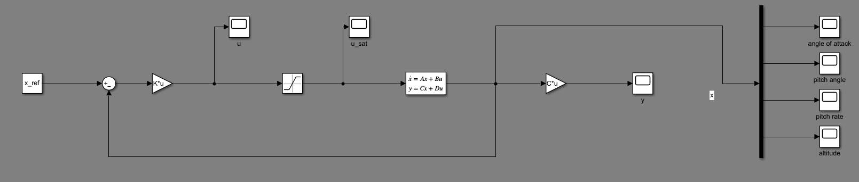
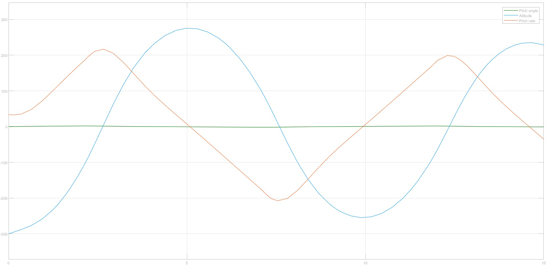
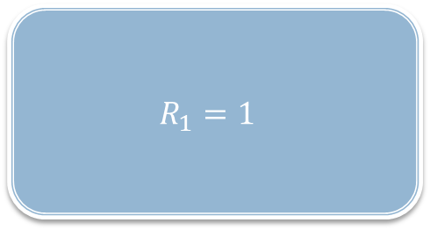
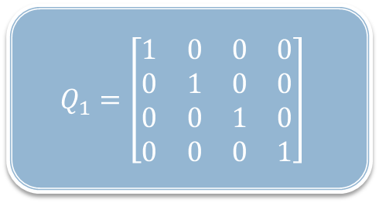
LQ Controller: 1° attempt
$$Q_{1}=\left[\begin{matrix}1 & 0 & 0 & 0 \\ 0 & 1 & 0 & 0 \\ 0 & 0 & 1 & 0 \\ 0 & 0 & 0 & 1\end{matrix}\right]$$
$$R_{1}=1$$

Slide 7
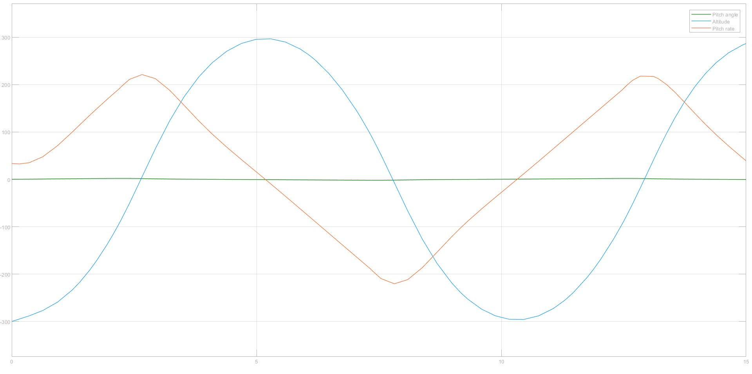

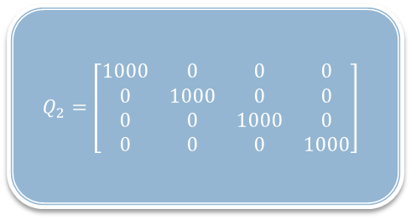
LQ Controller: 2° attempt
$$Q_{2}=\left[\begin{matrix}1000 & 0 & 0 & 0 \\ 0 & 1000 & 0 & 0 \\ 0 & 0 & 1000 & 0 \\ 0 & 0 & 0 & 1000\end{matrix}\right]$$
$$R_{2}=1$$

Slide 8
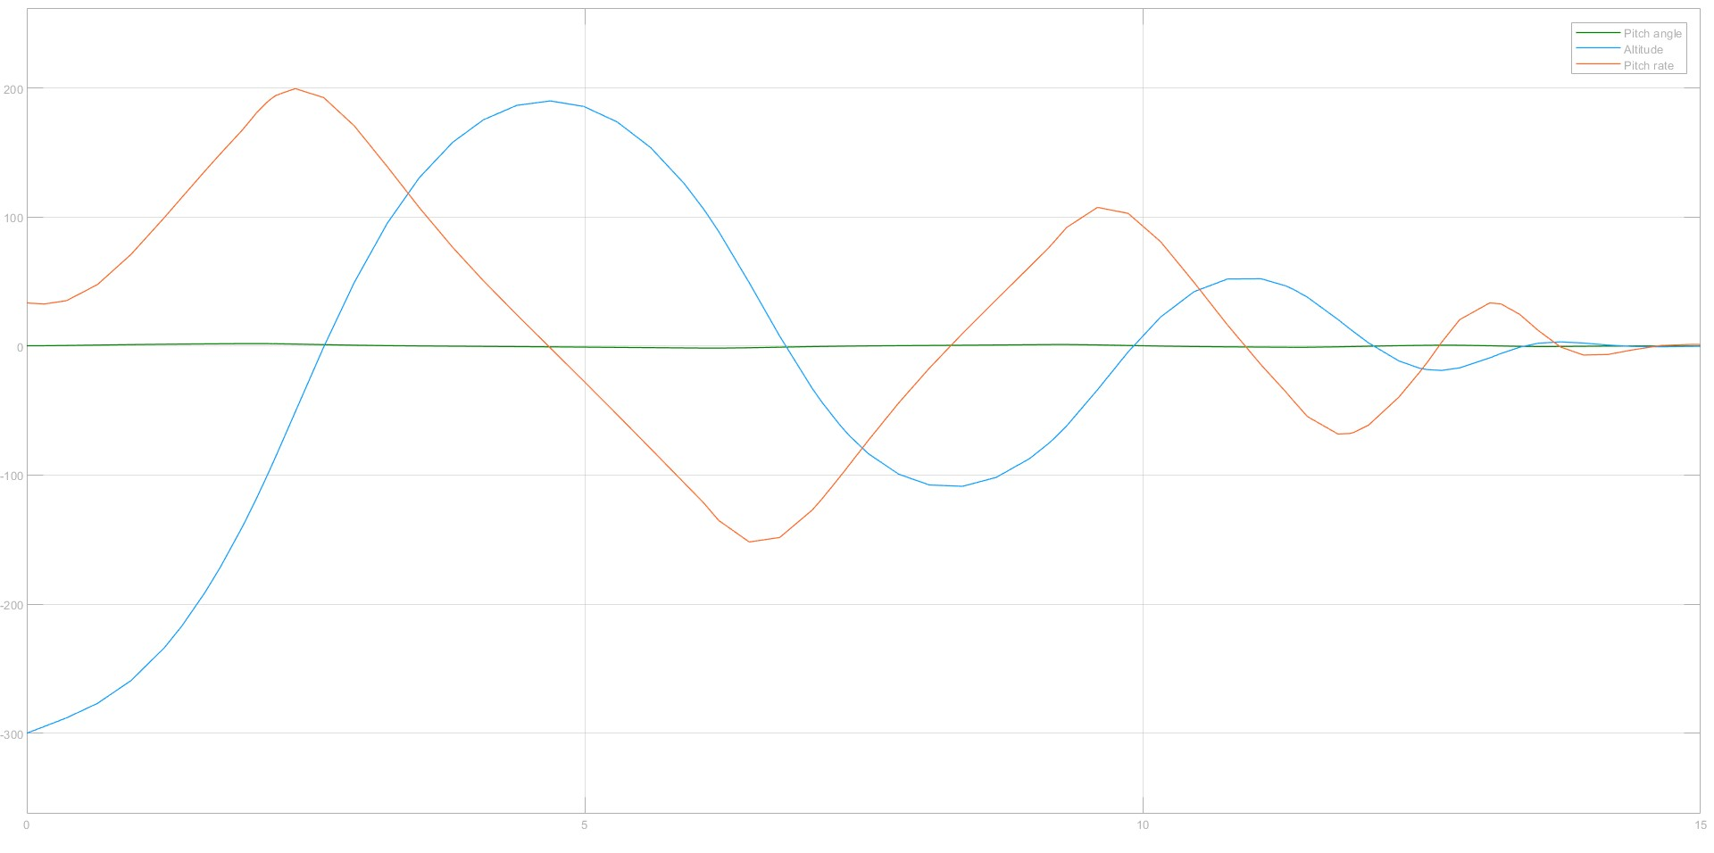
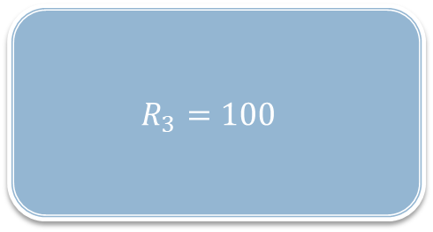
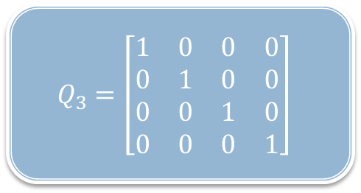
LQ Controller: 3° attempt
$$Q_{3}=\left[\begin{matrix}1 & 0 & 0 & 0 \\ 0 & 1 & 0 & 0 \\ 0 & 0 & 1 & 0 \\ 0 & 0 & 0 & 1\end{matrix}\right]$$
$$R_{3}=100$$

Slide 9
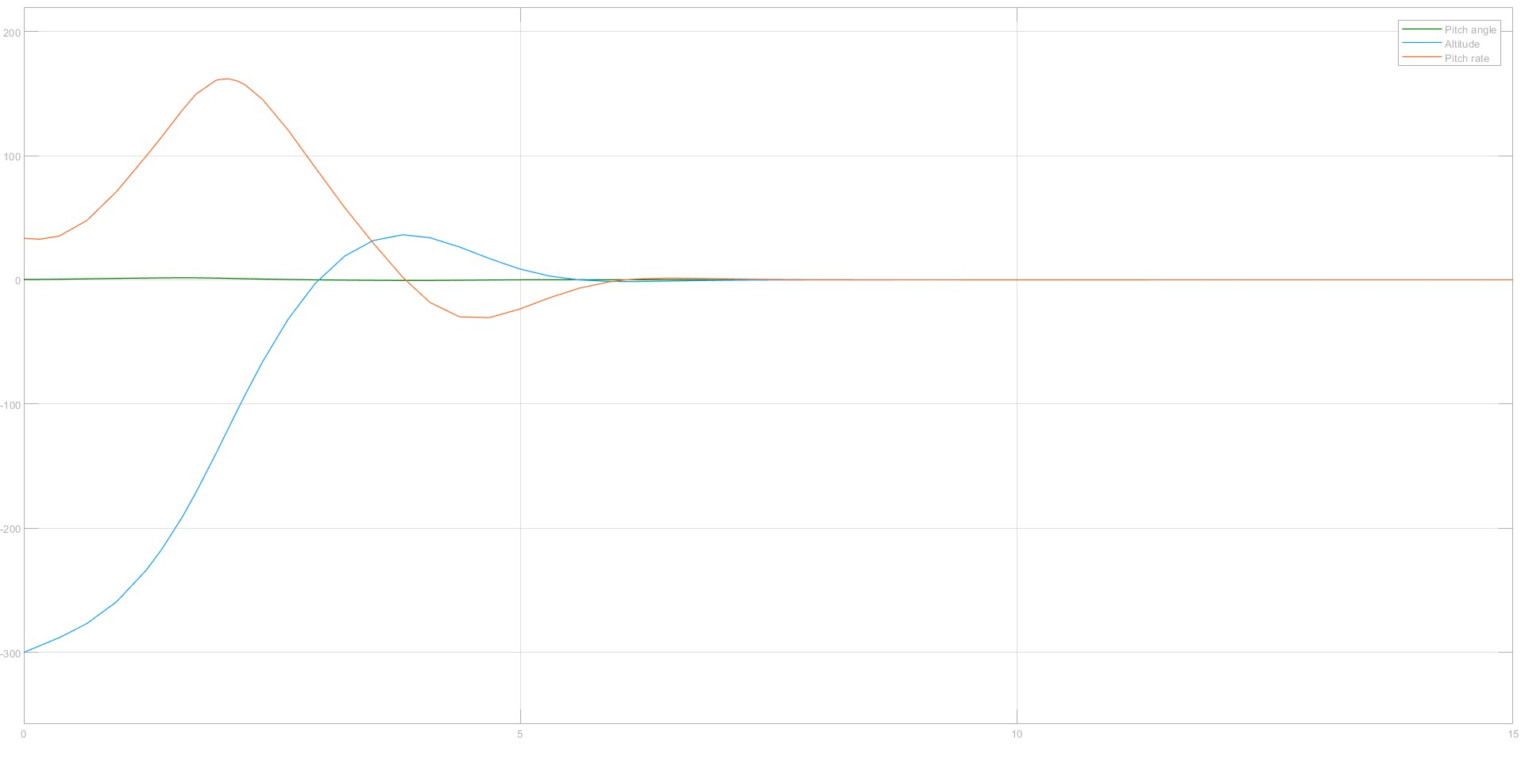
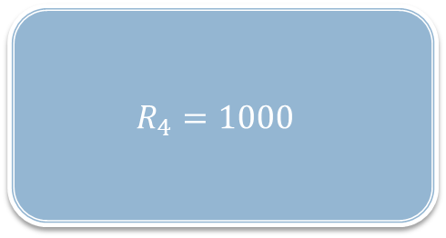

LQ Controller: 4° attempt
$$Q_{4}=\left[\begin{matrix}1 & 0 & 0 & 0 \\ 0 & 1 & 0 & 0 \\ 0 & 0 & 1 & 0 \\ 0 & 0 & 0 & 1\end{matrix}\right]$$
$$R_{4}=1000$$

Slide 10
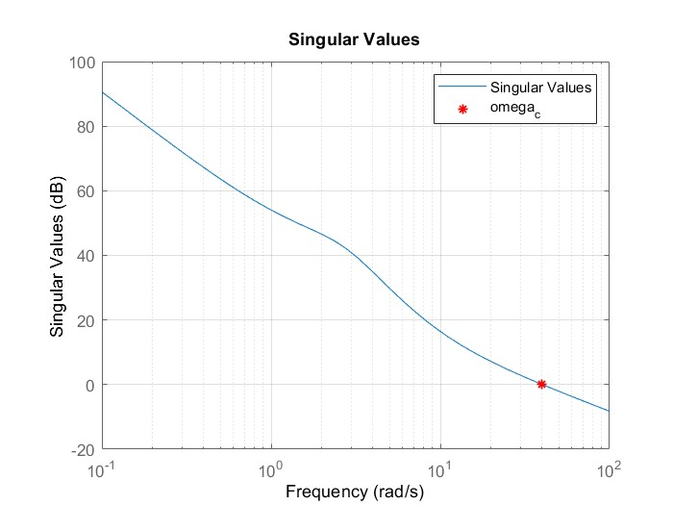
LQ Controller Discrete Time
Shannon Theorem
$$ω_{sampling}>2∗ω_{c}$$
𝜔_𝑠𝑎𝑚𝑝𝑙𝑖𝑛𝑔>2∗𝜔_𝑐
$$T_{sampling}=\frac{2∗π}{ω_{c}}=0,0793 s$$
𝑇_𝑠𝑎𝑚𝑝𝑙𝑖𝑛𝑔=(2∗𝜋)/𝜔_𝑐 =0,0793 𝑠
$$ω_{sampling}=2∗π∗f_{sampling}=\frac{2∗π}{T_{sampling}}$$
𝜔_𝑠𝑎𝑚𝑝𝑙𝑖𝑛𝑔=2∗𝜋∗𝑓_𝑠𝑎𝑚𝑝𝑙𝑖𝑛𝑔=(2∗𝜋)/𝑇_𝑠𝑎𝑚𝑝𝑙𝑖𝑛𝑔
$$f_{sampling}=\frac{1}{T_{sampling}}$$
𝑓_𝑠𝑎𝑚𝑝𝑙𝑖𝑛𝑔=1/𝑇_𝑠𝑎𝑚𝑝𝑙𝑖𝑛𝑔
Notes:
PUNTO 2

Slide 11
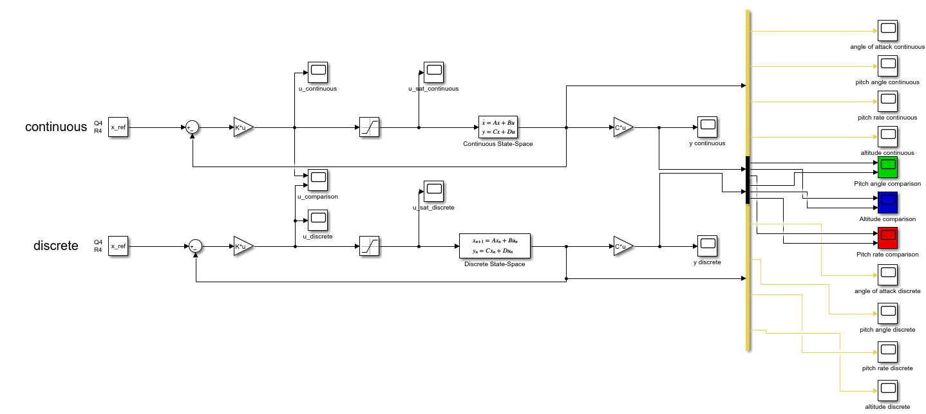
LQ Controller Discrete Time
Simulink Scheme: Discretized Controller ($Q_{4}$, $R_{4}$)
Simulink Scheme: Discretized Controller (𝑄_4, 𝑅_4)

Slide 12
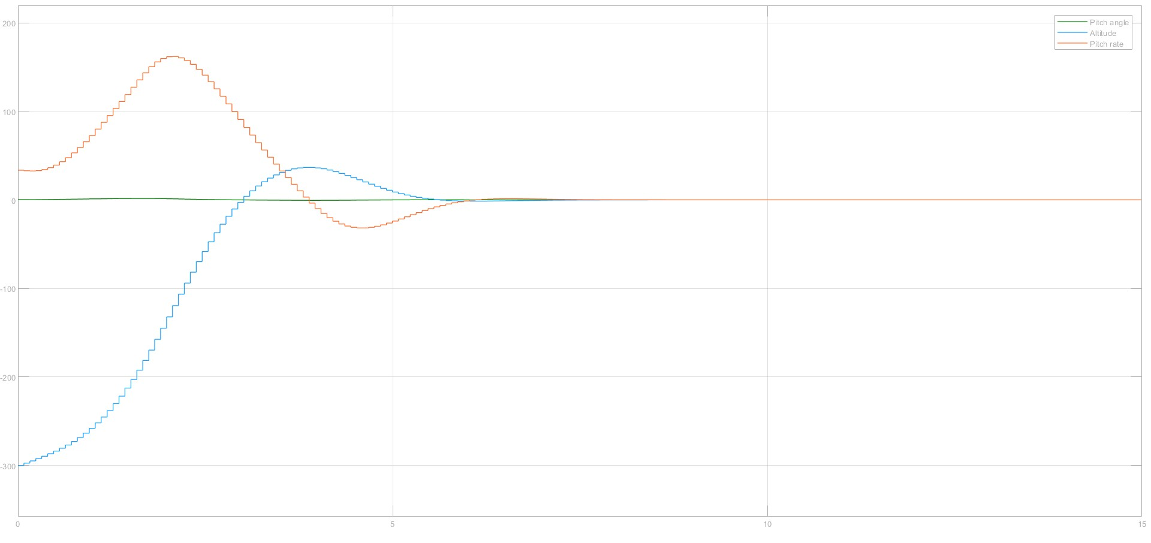
LQ Controller Discrete Time
Results for Discretized Controller

Slide 13
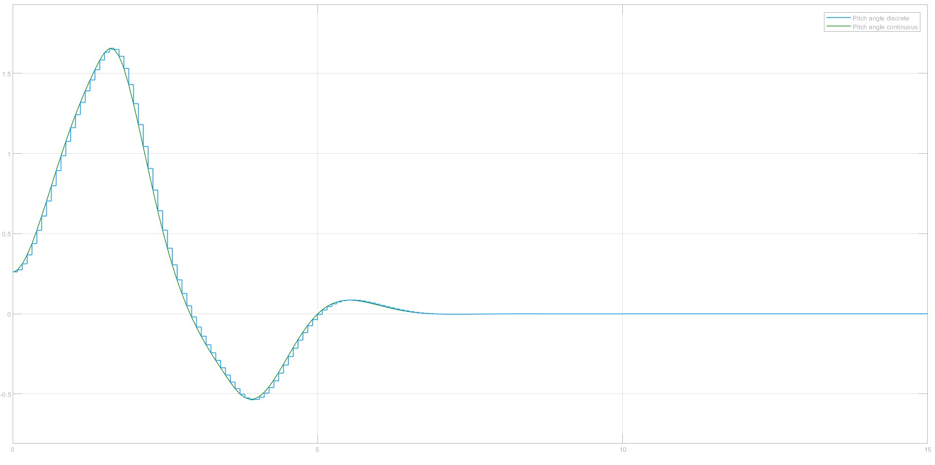
LQ Controller Discrete Time
Comparison between Continuous and Discrete: Pitch Angle

Slide 14
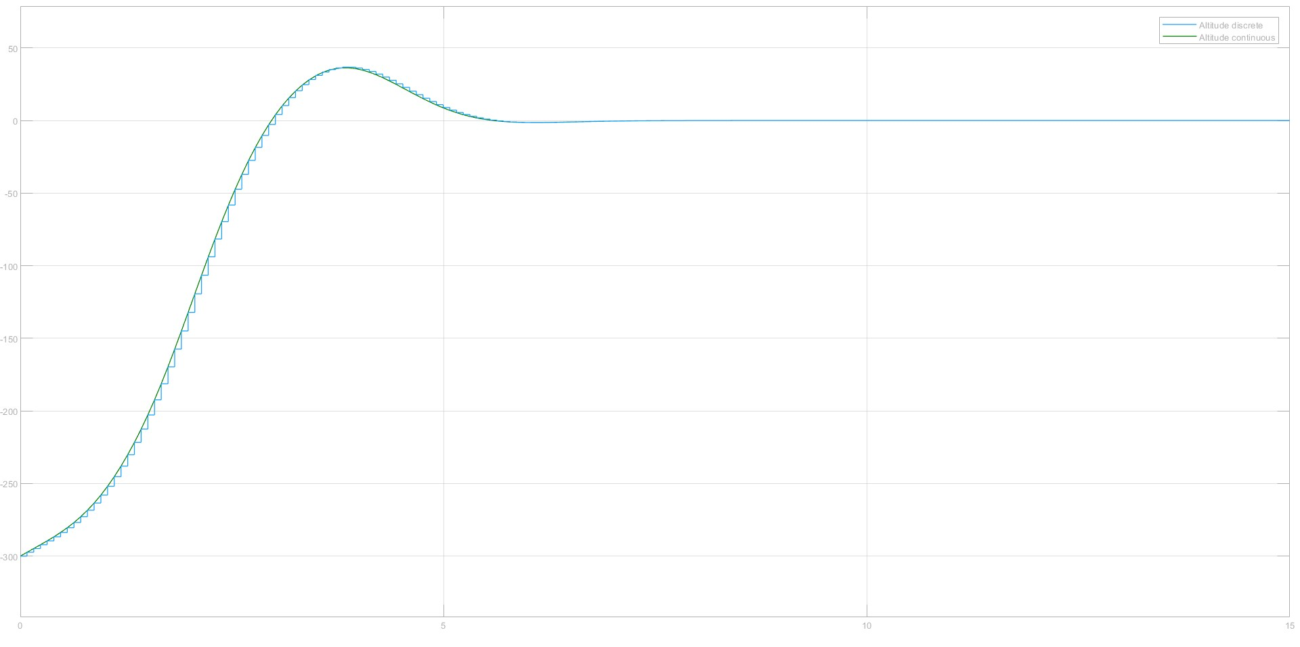
LQ Controller Discrete Time
Comparison between Continuous and Discrete: Altitude

Slide 15
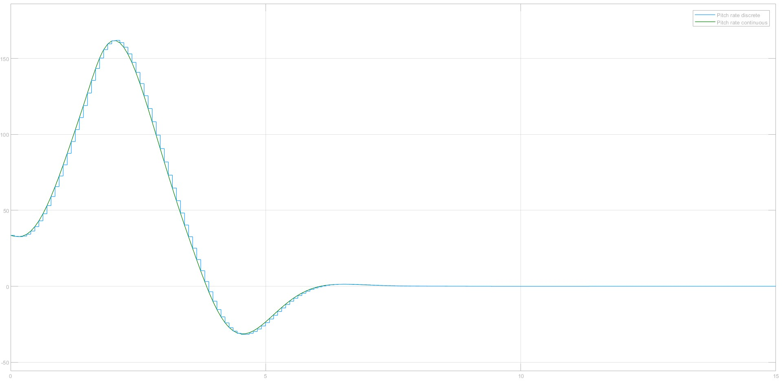
LQ Controller Discrete Time
Comparison between Continuous and Discrete: Pitch Rate

Slide 16
MPC Controller
General rules for computing MPC controller
MPC is based on cost minimization in $N$ horizon steps
MPC is based on cost minimization in 𝑁 horizon steps
AS not always guaranteed
For AS stability results in uncostrained case:
Boundary matrix $S$ equal to Riccati solution equation $\overline{P}$ even if optimal control problem is not feasable with constraints.
Boundary matrix 𝑆 equal to Riccati solution equation 𝑃 ̅ even if optimal control problem is not feasable with constraints.
If $N$ short we cannot acheive AS
If 𝑁 short we cannot acheive AS
$N$ horizon sufficently long
𝑁 horizon sufficently long
Notes:
PUNTO 3

Slide 17
MPC Controller
MPC of linear systems in state space form
$$Model:\left\{\begin{aligned}x\left(k+1\right)=A x\left(k\right)+B u(k) \\ y\left(k\right)=C(k)\end{aligned}\right.$$
𝑀𝑜𝑑𝑒𝑙:{█(𝑥(𝑘+1)=𝐴 𝑥(𝑘)+𝐵 𝑢(𝑘)@𝑦(𝑘)=𝐶(𝑘))┤
$$Cost function:J\left(x\left(k\right),u\left(.\right),k\right)=\sum_{i=0}^{N−1}{\left({\left\|x(k+i)\right\|}_{Q}^{2}+{\left\|u(k+i)\right\|}_{R}^{2}\right)+{\left\|x(k+N)\right\|}_{S}^{2}}$$
𝐶𝑜𝑠𝑡 𝑓𝑢𝑛𝑐𝑡𝑖𝑜𝑛:𝐽(𝑥(𝑘),𝑢(.),𝑘)=∑24_(𝑖=0)^(𝑁−1)▒〖(‖𝑥(𝑘+𝑖)‖_𝑄^2+‖𝑢(𝑘+𝑖)‖_𝑅^2 )+‖𝑥(𝑘+𝑁)‖_𝑆^2 〗
$$N→Prediction horizon$$
𝑁→𝑃𝑟𝑒𝑑𝑖𝑐𝑡𝑖𝑜𝑛 ℎ𝑜𝑟𝑖𝑧𝑜𝑛
$$Q=Q^{′}≥0, R=R^{′}>0,S=S′≥0$$
𝑄=𝑄^′≥0, 𝑅=𝑅^′>0,𝑆=𝑆′≥0
$$x∈R^{n}, u∈R^{m}, y∈R^{p}$$
𝑥∈𝑅^𝑛, 𝑢∈𝑅^𝑚, 𝑦∈𝑅^𝑝
$Control sequence→u(k), u\left(k+1\right),…,u(k+1−N)$
𝐶𝑜𝑛𝑡𝑟𝑜𝑙 𝑠𝑒𝑞𝑢𝑒𝑛𝑐𝑒→𝑢(𝑘), 𝑢(𝑘+1),…,𝑢(𝑘+1−𝑁)

Slide 18
MPC Controller
Open Loop solution
$$x\left(k+i\right)=A^{i}x\left(k\right)+\sum_{j=0}^{i−1}{A^{i−j−1}}Bu\left(k+j\right), i>0$$
𝑥(𝑘+𝑖)=𝐴^𝑖 𝑥(𝑘)+∑24_(𝑗=0)^(𝑖−1)▒𝐴^(𝑖−𝑗−1) 𝐵𝑢(𝑘+𝑗), 𝑖>0
$X\left(k\right)=\left[\begin{matrix}x(k+1) \\ x(k+2) \\ ⋮ \\ x\left(k+N−1\right) \\ x(k+N)\end{matrix}\right]$, $𝒜=\left[\begin{matrix}A \\ A^{2} \\ ⋮ \\ A^{N−1} \\ A^{N}\end{matrix}\right]$, $U\left(k\right)=\left[\begin{matrix}u(k) \\ u(k+1) \\ ⋮ \\ u\left(k+N−2\right) \\ u(k+N−1)\end{matrix}\right]$, $ℬ=\left[\begin{matrix}B & 0 & ⋯ & 0 & 0 \\ AB & B & ⋯ & 0 & 0 \\ ⋮ & ⋮ & ⋱ & ⋮ & ⋮ \\ A^{N−2}B & A^{N−3}B & … & B & 0 \\ A^{N−1}B & A^{N−2}B & … & AB & B\end{matrix}\right]$
𝑋(𝑘)=[■8(𝑥(𝑘+1)@𝑥(𝑘+2)@⋮@𝑥(𝑘+𝑁−1)@𝑥(𝑘+𝑁))], 𝒜=[■8(𝐴@𝐴^2@⋮@𝐴^(𝑁−1)@𝐴^𝑁 )], 𝑈(𝑘)=[■8(𝑢(𝑘)@𝑢(𝑘+1)@⋮@𝑢(𝑘+𝑁−2)@𝑢(𝑘+𝑁−1))], ℬ=[■8(𝐵&0&⋯&0&0@𝐴𝐵&𝐵&⋯&0&0@⋮&⋮&⋱&⋮&⋮@𝐴^(𝑁−2) 𝐵&𝐴^(𝑁−3) 𝐵&…&𝐵&0@𝐴^(𝑁−1) 𝐵&𝐴^(𝑁−2) 𝐵&…&𝐴𝐵&𝐵)]

Slide 19
MPC Controller
Open Loop solution
$$X\left(k\right)=𝒜x\left(k\right)+ℬU(k)$$
𝑋(𝑘)=𝒜𝑥(𝑘)+ℬ𝑈(𝑘)
$$𝒬=\left[\begin{matrix}Q & 0 & ⋯ & 0 & 0 \\ 0 & Q & ⋯ & 0 & 0 \\ ⋮ & ⋮ & ⋱ & ⋮ & ⋮ \\ 0 & 0 & ⋯ & Q & 0 \\ 0 & 0 & … & 0 & S\end{matrix}\right], ℛ=\left[\begin{matrix}R & 0 & ⋯ & 0 & 0 \\ 0 & R & ⋯ & 0 & 0 \\ ⋮ & ⋮ & ⋱ & ⋮ & ⋮ \\ 0 & 0 & ⋯ & R & 0 \\ 0 & 0 & … & 0 & R\end{matrix}\right]$$
𝒬=[■8(𝑄&0&⋯&0&0@0&𝑄&⋯&0&0@⋮&⋮&⋱&⋮&⋮@0&0&⋯&𝑄&0@0&0&…&0&𝑆)], ℛ=[■8(𝑅&0&⋯&0&0@0&𝑅&⋯&0&0@⋮&⋮&⋱&⋮&⋮@0&0&⋯&𝑅&0@0&0&…&0&𝑅)]
$$arg\left\{\min_{u(.)}{J(x\left(k\right),u\left(.\right),k)}\right\}=arg\left\{\min_{U(k)}{\overline{J}(x\left(k\right),U\left(k\right),k)}\right\}$$
𝑎𝑟𝑔{min_(𝑢(.))⁡〖𝐽(𝑥(𝑘),𝑢(.),𝑘)〗 }=𝑎𝑟𝑔{min_(𝑈(𝑘))⁡〖𝐽 ̅(𝑥(𝑘),𝑈(𝑘),𝑘)〗 }
$$\overline{J}\left(x\left(k\right),U\left(k\right),k\right)=X^{′}\left(k\right)𝒬X\left(k\right)+U′(k)ℛU(k)$$
𝐽 ̅(𝑥(𝑘),𝑈(𝑘),𝑘)=𝑋^′ (𝑘)𝒬𝑋(𝑘)+𝑈′(𝑘)ℛ𝑈(𝑘)

Slide 20
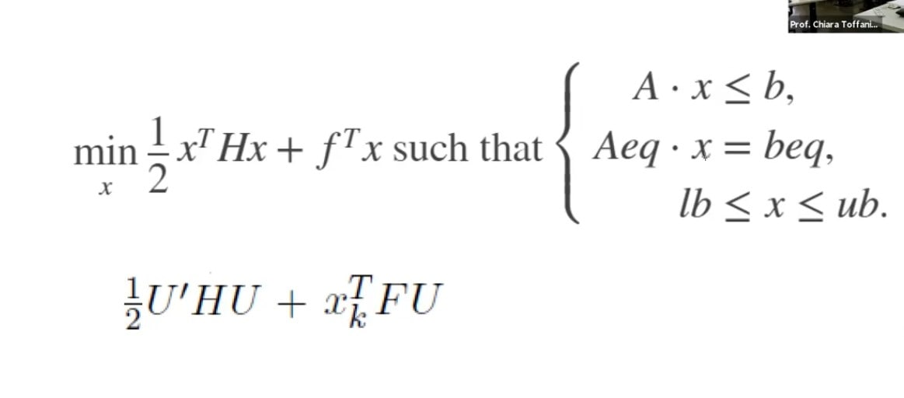
MPC Controller
Quadprog in Matlab
$$H=ℬ^{′}𝒬ℬ+ℛ$$
𝐻=ℬ^′ 𝒬ℬ+ℛ
Matlab function:
$$F=𝒜′𝒬ℬ$$
𝐹=𝒜′𝒬ℬ
Notes:
$$lb=−0,262 rad; ub=0,262 rad$$

Slide 21
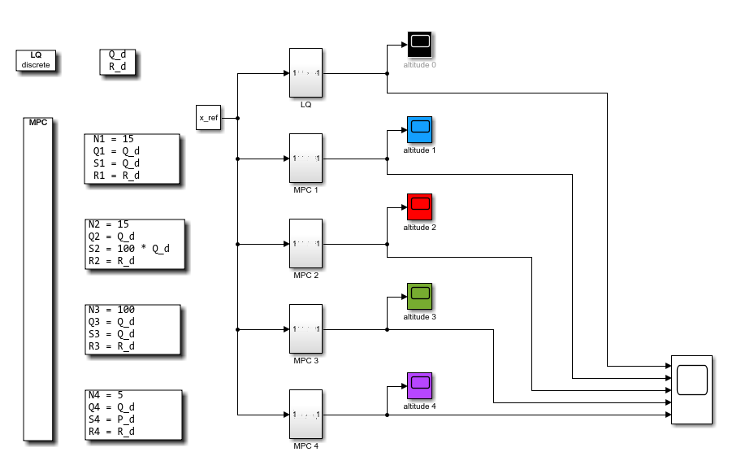
MPC without info on control constraints
MPC without info in control constraints (Q_d$=Q_{4}$, R_d=$R_{4}$)
MPC without info in control constraints (Q_d=𝑄_4, R_d=𝑅_4)

Slide 22
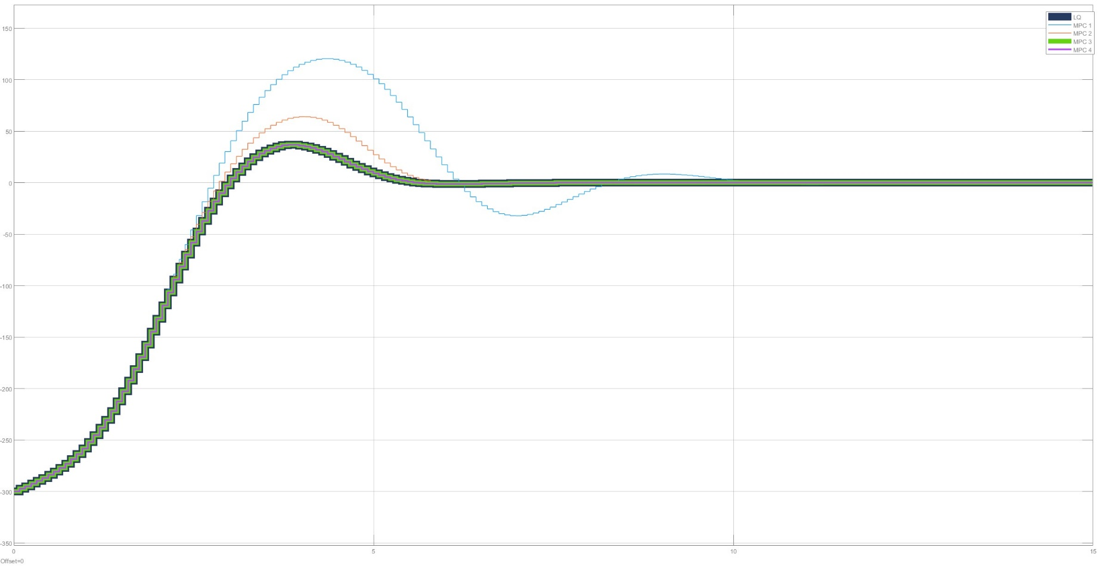
MPC without info on control constraints
Results for MPC without info on control constraints

Slide 23
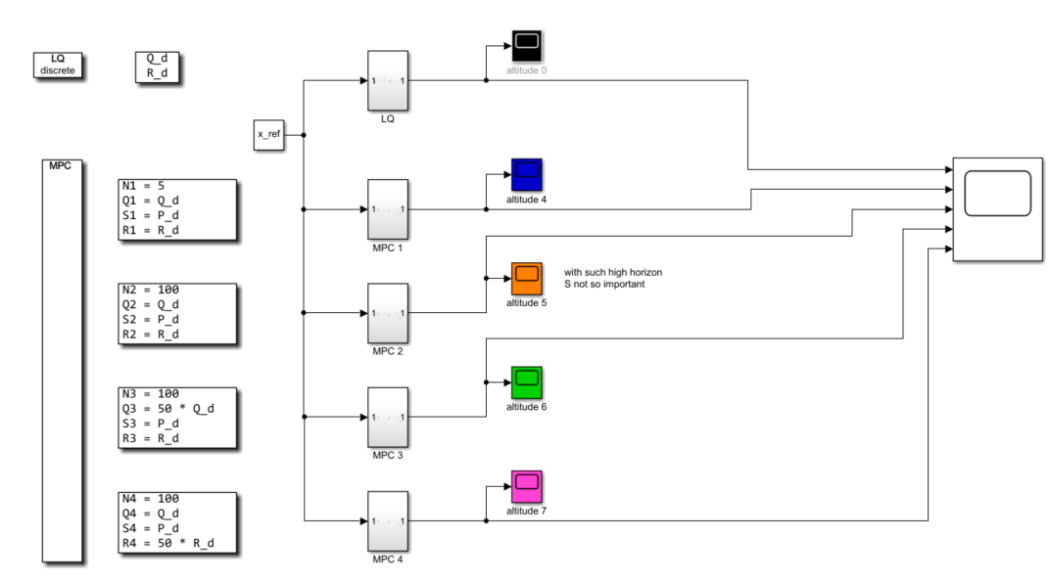
MPC with info on control constraints
MPC with info on control constraints (Q_d$=Q_{4}$, R_d=$R_{4}$)
MPC with info on control constraints (Q_d=𝑄_4, R_d=𝑅_4)
$$lb=−0,262 rad; ub=0,262 rad$$
Notes:
PUNTO 4

Slide 24
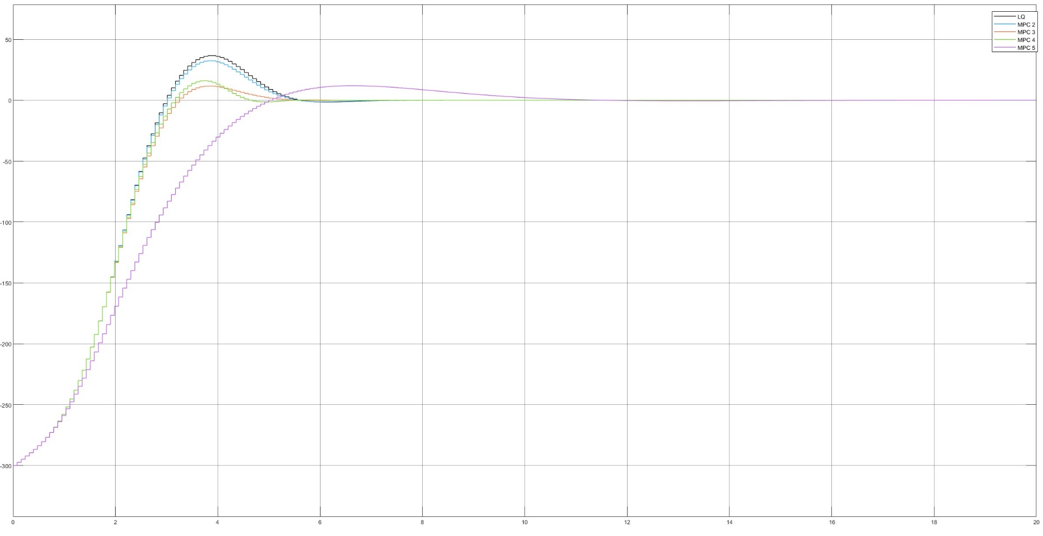
MPC with info on control constraints
Results for MPC with info on control constraints

Slide 25
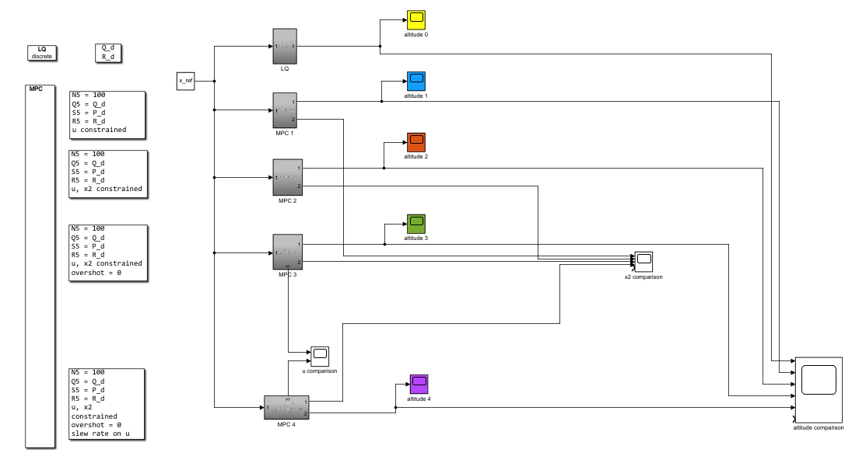
MPC with constraints
MPC with constraints (Q_d$=Q_{4}$, R_d=$R_{4}$)
MPC with constraints (Q_d=𝑄_4, R_d=𝑅_4)

Slide 26
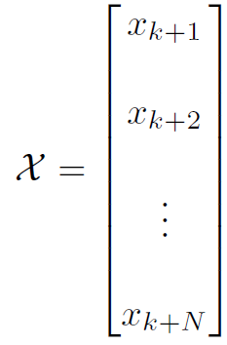
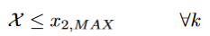
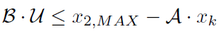
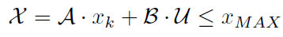
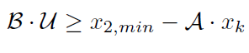
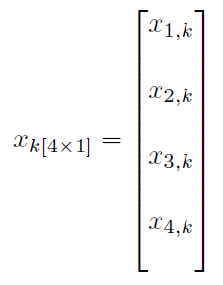
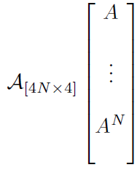
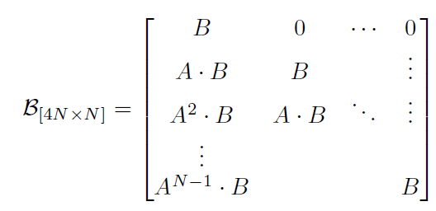
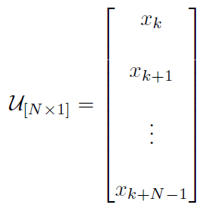
MPC with constraints on pitch angle state : x2
Implementation
Notes:
PUNTO 5

Slide 27
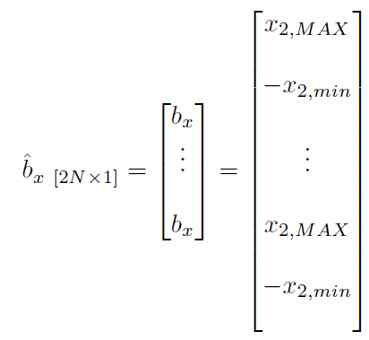
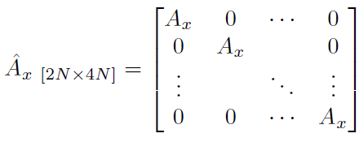
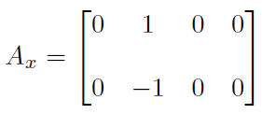
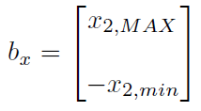
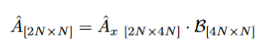
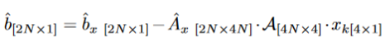
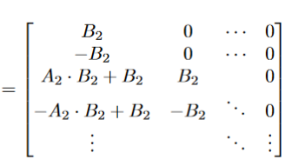
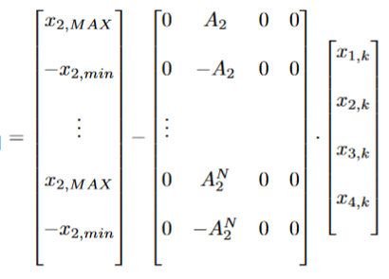
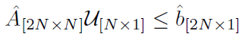
MPC with constraints on pitch angle state : x2
Implementation

Slide 28
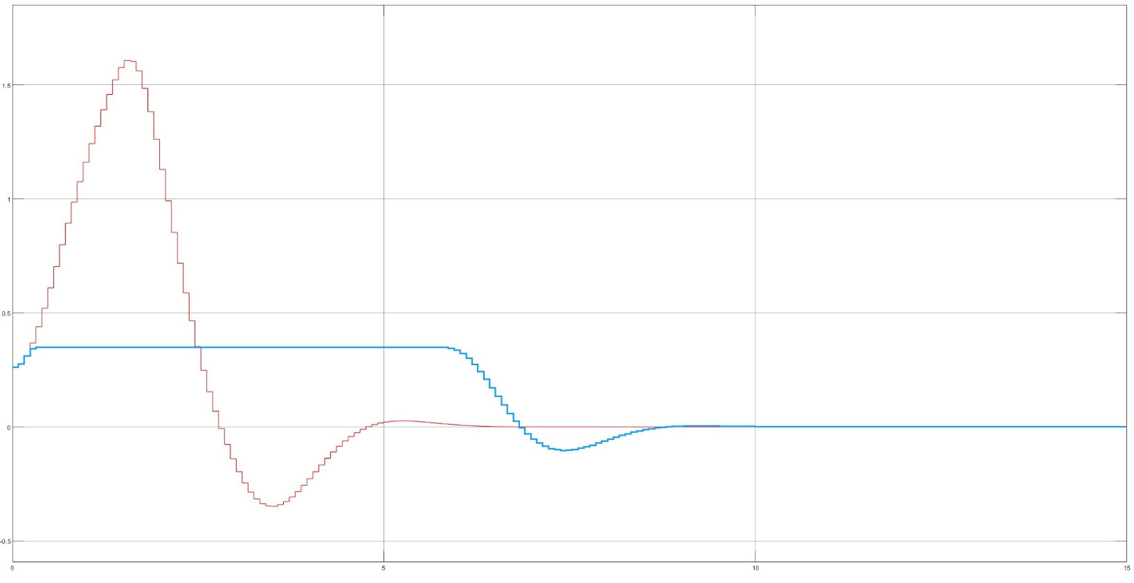
MPC with constraints on pitch angle state : x2
SETTINGS:
Pitch angle <= (+/-) 20°
<= 0,262 rad
Blue: pitch angle costrained
Red: without pitch angle costraint

Slide 29
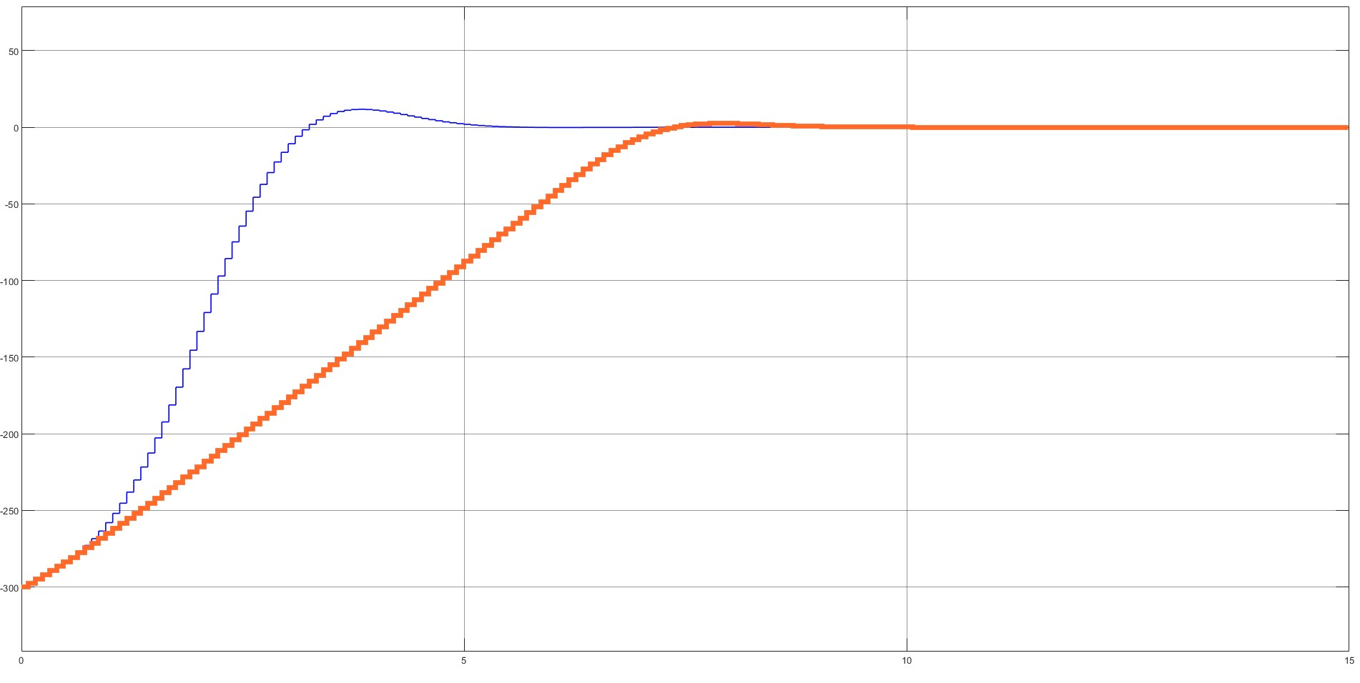
MPC with overshot constraint on altitude state : x2
X4 comparison: with set costrain (red) we have a much slower system on x4 but we can reduce the overshot

Slide 30
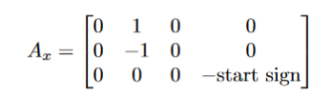
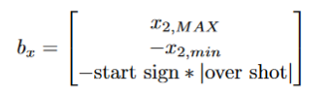
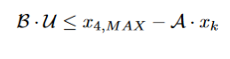




MPC with overshot constraint on altitude state : x4
Implementation

Slide 31


MPC with overshot constraint on altitude state : x4
Historical mpc comparison since LQ
SETTINGS
Overshot set: 0;
Altitude comparison zoomed: with set costrain (green) we have no overshot

Slide 32

MPC with overshot constraint on altitude state : x4
X2 comparison: with set costrain (black) we have slightly worst performance but x2 constrain remains satisfied

Slide 33






MPC with slew rate costraint on input
$∆U≤|0,524\frac{rad}{s}∗ T_{sampling}$|

Slide 34


MPC with slew rate costrain on input
U comparison with slew rate costraint
SETTINGS:
$$Slew rate≤0,524\frac{rad}{s}∗ T_{sampling}$$

Slide 35

MPC with slew rate costrain on input
With slew rate constraint, the state x4 is not altered

Slide 36

Kalman filter
Optimal observer
State estimation since states measurements are not available
$u^{o}\left(k\right)=−K\left(0\right)[\hat{x}\left(k\right)−x_{ref}$]
Notes:
POINT 8

Slide 37

Kalman filter: state comparison

Slide 38
MPC with Control Constraints
Control Constraints
$u_{min}≤u\left(k\right)≤u_{max} ∀k$
𝑢_𝑚𝑖𝑛≤𝑢(𝑘)≤𝑢_𝑚𝑎𝑥 ∀𝑘
$A_{u}u\left(k\right)≤b_{u} ∀k∈[0;N−1]$
𝐴_𝑢 𝑢(𝑘)≤𝑏_𝑢 ∀𝑘∈[0;𝑁−1]
${\hat{A}}_{u}=\left[\begin{matrix}A_{u} & 0 & ⋯ & 0 \\ 0 & A_{u} & ⋯ & 0 \\ ⋮ & ⋮ & ⋱ & ⋮ \\ 0 & 0 & ⋯ & A_{u}\end{matrix}\right], {\hat{b}}_{u}=\left[\begin{matrix}b_{u} \\ b_{u} \\ ⋮ \\ b_{u}\end{matrix}\right]$
𝐴 ̂_𝑢=[■8(𝐴_𝑢&0&⋯&0@0&𝐴_𝑢&⋯&0@⋮&⋮&⋱&⋮@0&0&⋯&𝐴_𝑢 )], 𝑏 ̂_𝑢=[■8(𝑏_𝑢@𝑏_𝑢@⋮@𝑏_𝑢 )]
$${\hat{A}}_{u}U(k)≤{\hat{b}}_{u}$$
𝐴 ̂_𝑢 𝑈(𝑘)≤𝑏 ̂_𝑢
States Constraints
$A_{x}x\left(k\right)≤b_{k} ∀k∈[1;N]$
𝐴_𝑥 𝑥(𝑘)≤𝑏_𝑘 ∀𝑘∈[1;𝑁]
$${\hat{A}}_{x}=\left[\begin{matrix}A_{x} & 0 & ⋯ & 0 \\ 0 & A_{x} & ⋯ & 0 \\ ⋮ & ⋮ & ⋱ & ⋮ \\ 0 & 0 & ⋯ & A_{x}\end{matrix}\right], {\hat{b}}_{x}=\left[\begin{matrix}b_{x} \\ b_{x} \\ ⋮ \\ b_{x}\end{matrix}\right]$$
𝐴 ̂_𝑥=[■8(𝐴_𝑥&0&⋯&0@0&𝐴_𝑥&⋯&0@⋮&⋮&⋱&⋮@0&0&⋯&𝐴_𝑥 )], 𝑏 ̂_𝑥=[■8(𝑏_𝑥@𝑏_𝑥@⋮@𝑏_𝑥 )]
$${\hat{A}}_{x}X\left(k\right)≤{\hat{b}}_{x}↔{\hat{A}}_{x}(𝒜x\left(k\right)+ℬU\left(k\right))≤{\hat{b}}_{x}$$
𝐴 ̂_𝑥 𝑋(𝑘)≤𝑏 ̂_𝑥↔𝐴 ̂_𝑥 (𝒜𝑥(𝑘)+ℬ𝑈(𝑘))≤𝑏 ̂_𝑥
$x_{min}≤x\left(k\right)≤x_{max} ∀k≥0$
𝑥_𝑚𝑖𝑛≤𝑥(𝑘)≤𝑥_𝑚𝑎𝑥 ∀𝑘≥0

Slide 39
MPC with Control Constraints
$\hat{A}=\left[\begin{matrix}{\hat{A}}_{x}ℬ \\ {\hat{A}}_{u}\end{matrix}\right]$, $\hat{b}=\left[\begin{matrix}{\hat{b}}_{x}−{\hat{A}}_{x}𝒜x(k) \\ {\hat{b}}_{u}\end{matrix}\right]$
𝐴 ̂=[■8(𝐴 ̂_𝑥 ℬ@𝐴 ̂_𝑢 )], 𝑏 ̂=[■8(𝑏 ̂_𝑥−𝐴 ̂_𝑥 𝒜𝑥(𝑘)@𝑏 ̂_𝑢 )]
$$\hat{A}U(k)≤\hat{b}$$
𝐴 ̂𝑈(𝑘)≤𝑏 ̂
Control Constraints States Constraints

Slide 40
Displacement diagrams
Modified trapezoidal

Slide 41
Motion Curve 01: Feeding Group
0° → 80° Rise
80° → 360° Dwell

Slide 42
Motion Curve 02: Pressing Group
0°→90° Ground
90°→135° Rise
135°→305° Dwell
305°→350° Fall
350°→360° Ground

Slide 43
Motion Curve 03: Cutting Group
0°→145° Ground
145°→220° Rise
220°→295° Fall
295°→360° Ground

Slide 44



Cutting group
Crank slider continuous
Crank slider go and return
Ball screw

Slide 45




Crank slider continuous
Connecting rod (b) 150 mm
Crank (a) 50 mm

Slide 46

Kinematics and dynamics Crank slider continuous
$$ω_{cycle}$$
$$=$$
$60 pieces/min$
$$\dot{α}= ω_{cycle}$$
Notes:
Cut resistance 15000N same independent from the section of the wire

Slide 47


Crank slider go and return
Connecting rod (b) 150 mm
Crank (a) 50 mm
Power balance
Inverse
kinematics

Slide 48
Kinematics and dynamics Crank slider go and return

Slide 49




Ball screw
Pitch of the screw (p) 2 mm
Trapezoidal screw M20 R = 10 mm
Inverse
kinematics

Slide 50
Kinematics and dynamics Ball screw

Slide 51





Motor-reducer sizing: ball screw (alpha and beta procedure)
$$∆x_{4}=300 m$$
Chosen
Motor 5
Reducer 6

Slide 52

Motor-reducer sizing: crank slider go and return (alpha and beta procedure)
Chosen
Motor 11
Reducer 2

Slide 53

Motor-reducer sizing: Crank slider continuous (static dimensioning)
Chosen
Motor 1
Reducer 8

Slide 54
Performance analysis
Different cutting length

Slide 55

Performance analysis
Comparison of motor weights
 | $$Ball screw$$ | $go and return$ | $$continuous$$
name | BLS-115 | BLS-191 | BLS-144
[kg] | $$8.5$$ | $$29.5$$ | 20.1

Slide 56

Possible improvements
Inverse
kinematics

Slide 57
Thank you for your attention!
Crippa Davide 509769
Moroni Gianluca 503424
Mongini Paolo 507997

